Slide 1
Convolution Matrix for Image Processing
Multimedia Information System
Lecturer: 鮑興國
Yacine Sahli E10715005
NTUST 2018-2019

Slide 2
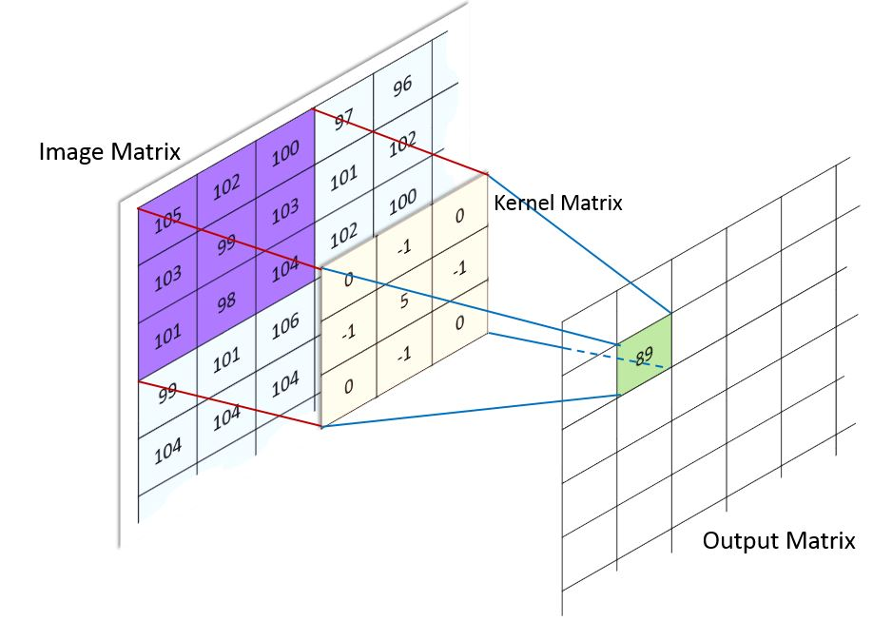
1. What is a Convolution Matrix ?

Slide 3
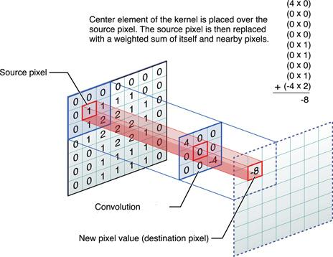
Example 1

Slide 4

Example 2
Convolution Matrix
1 | 0 | 1
0 | 1 | 0
1 | 0 | 1

Slide 5
What about the border ?
Extend → outside pixels = value of the closest pixel in the source image
Wrap → outside pixels = value of the pixel at the opposite side of the source image
Mirror → outside pixels = value of the pixel inside the image ( borders of the image act like mirrors )

Slide 6
2. What can we do with Matrix convolution?

Slide 7
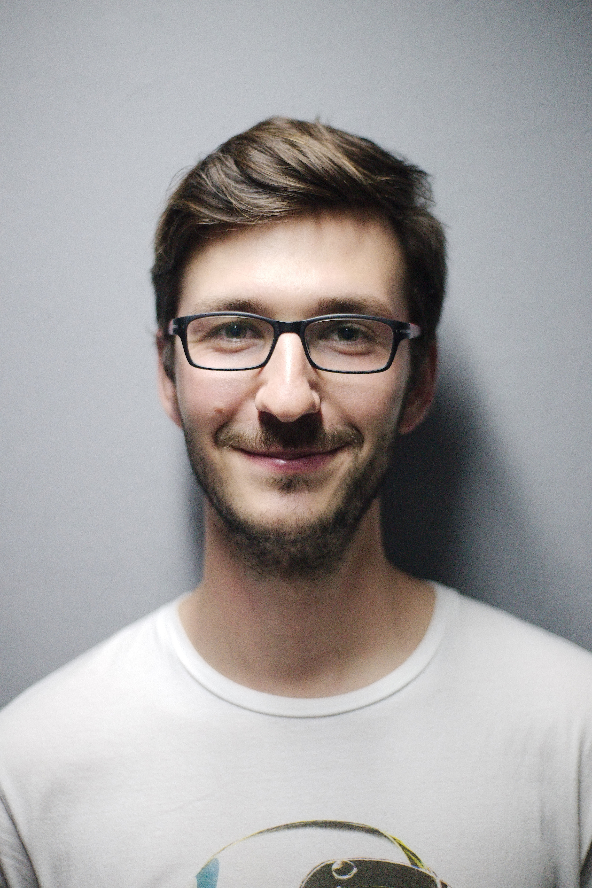
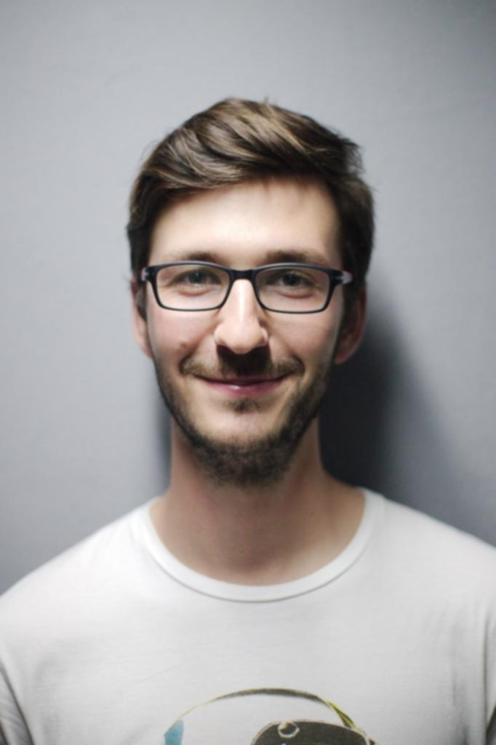


2. Example 1:Gaussian Blur filter
Convolution Matrix
1 | 4 | 6 | 4 | 1
4 | 16 | 24 | 16 | 4
6 | 24 | -476 | 24 | 6
4 | 16 | 24 | 16 | 4
1 | 4 | 6 | 4 | 1

Slide 8
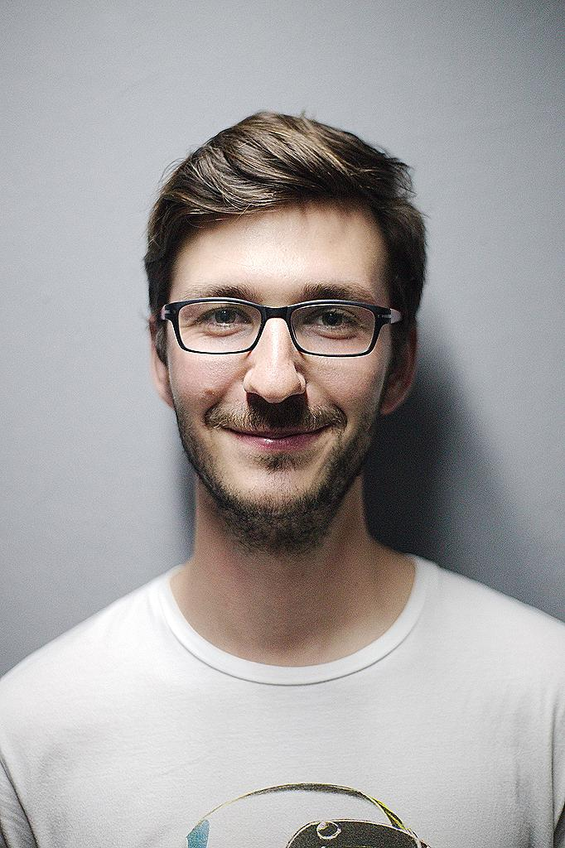
2. Example 2: Sharpening filter
Convolution Matrix
0 | -1 | 0
-1 | 5 | -1
0 | -1 | 0

Slide 9
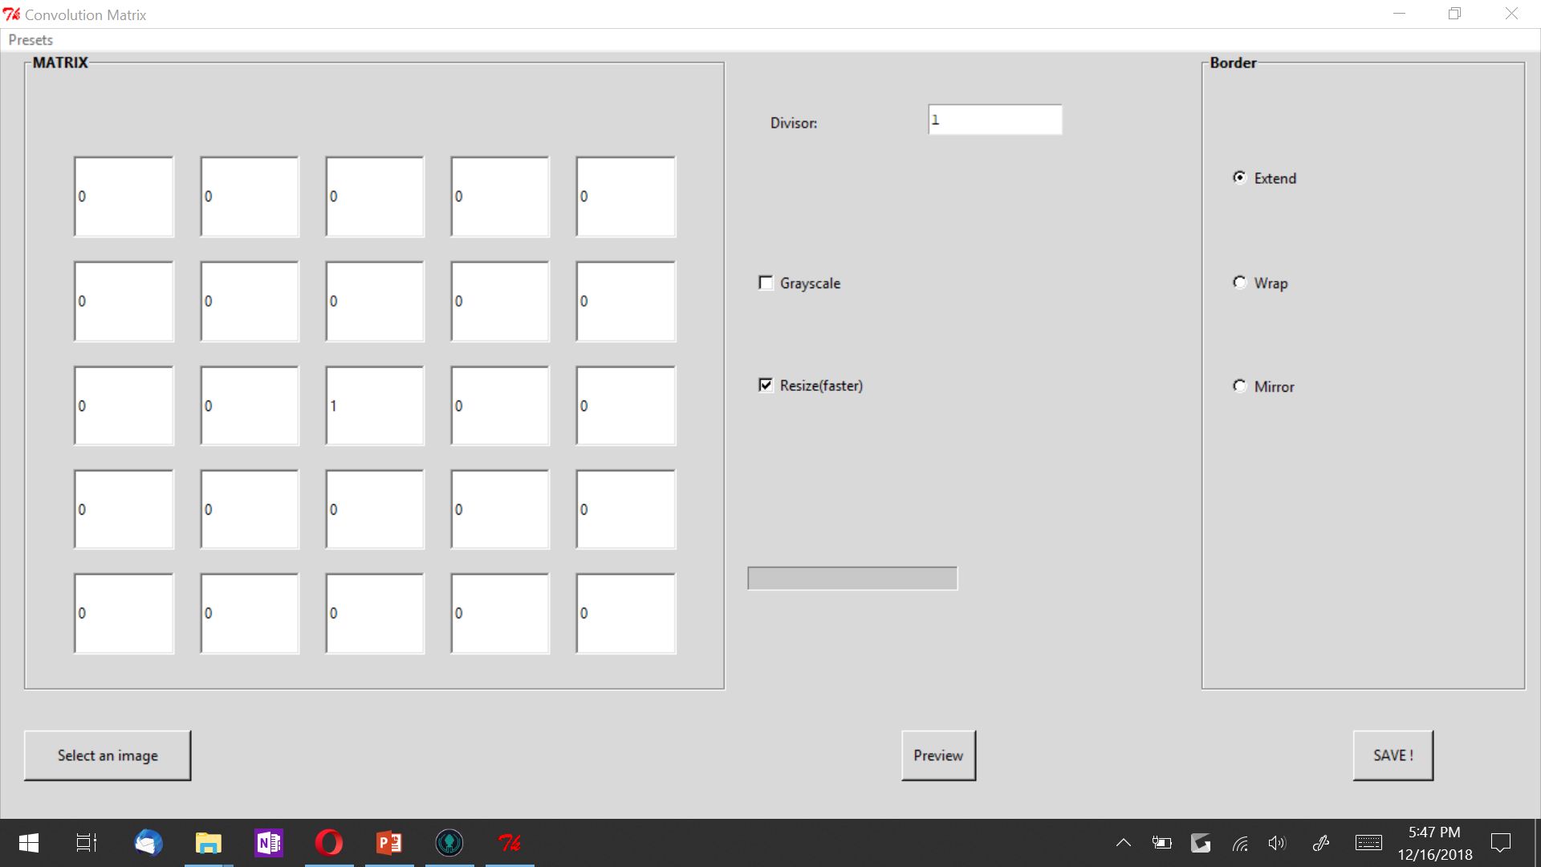
Place your screenshot here

Slide 10
THANKS!
Any questions?

